Slide 1
서버 프로그래밍
TCP 프로토콜

Slide 2
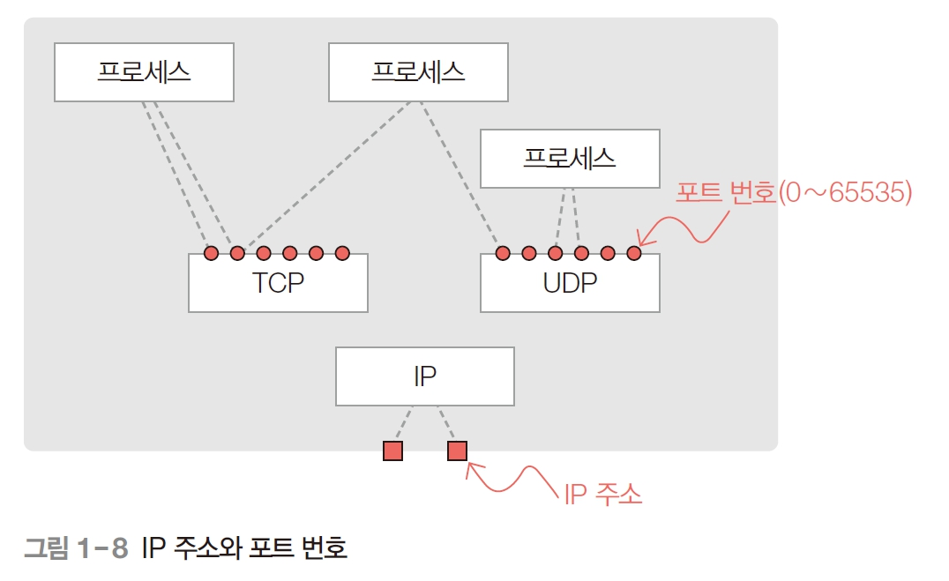
IP 주소와 Port 번호

Slide 3
네트워크 장비 정보 확인
내 장치 정보 확인 명령어
Win+R >> cmd 명령프롬프트
Win+R >> powershell 파워셀 (추천)
ipconfig, ipconfig /all, ipconfig /displaydns
IPv4, subnet, Gateway, DNS mac address
netstat, netstat –a, netstat –r
nslookup [URL]
ping [ipaddress, URL]

Slide 4
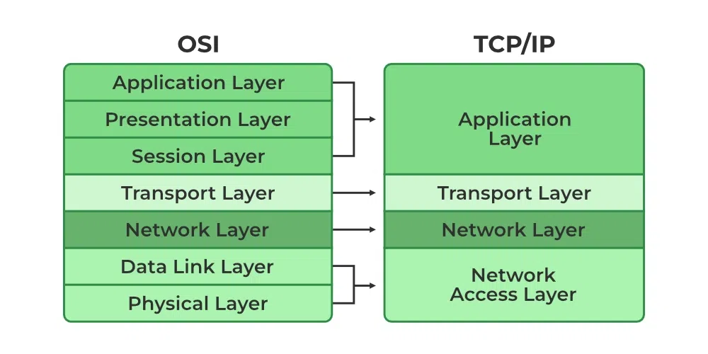
TCP/IP 프로토콜

Slide 5
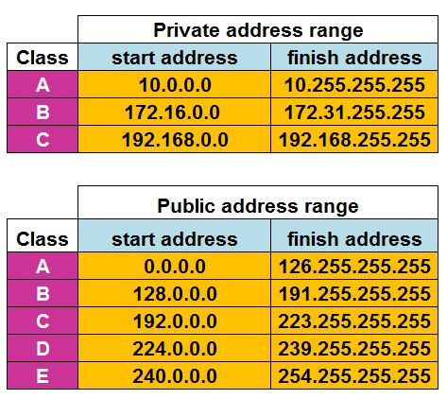
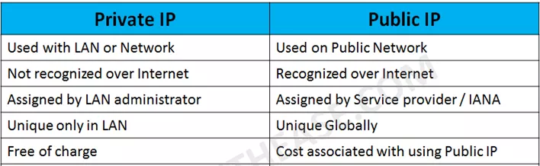
IPv4 private vs public address

Slide 6
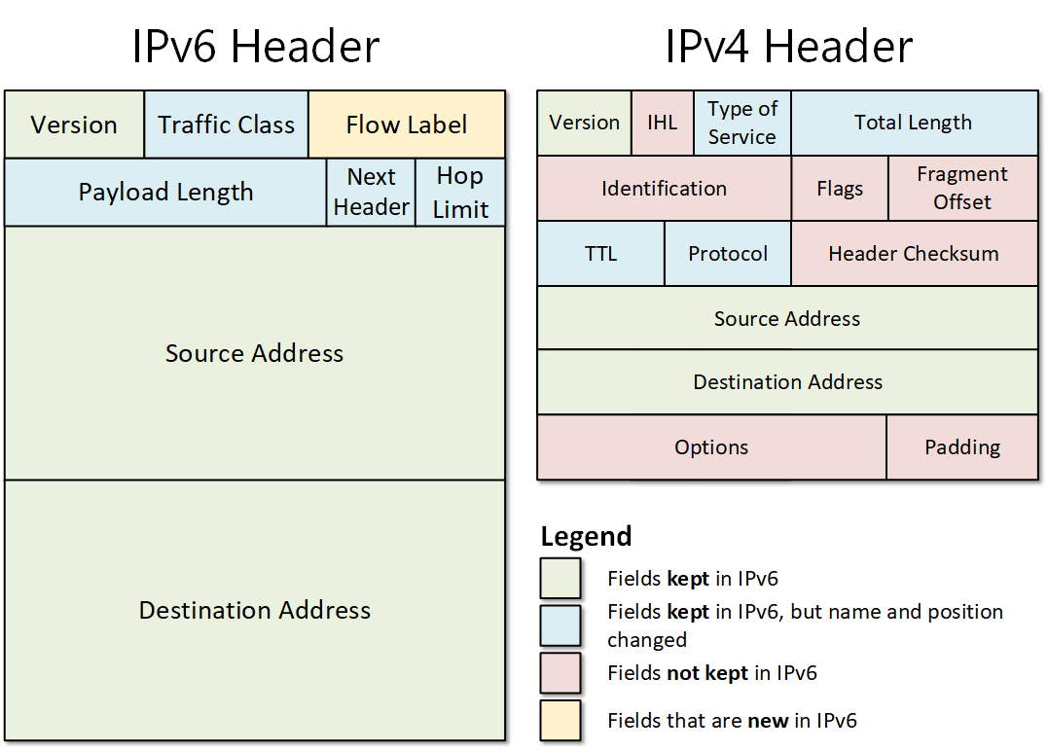
IPv4v6 Header

Slide 7
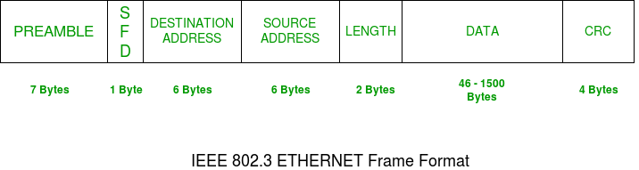
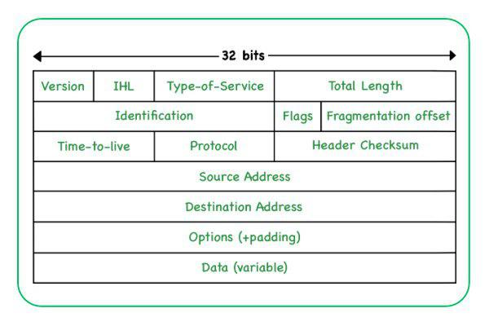
IPv4 Header

Slide 8
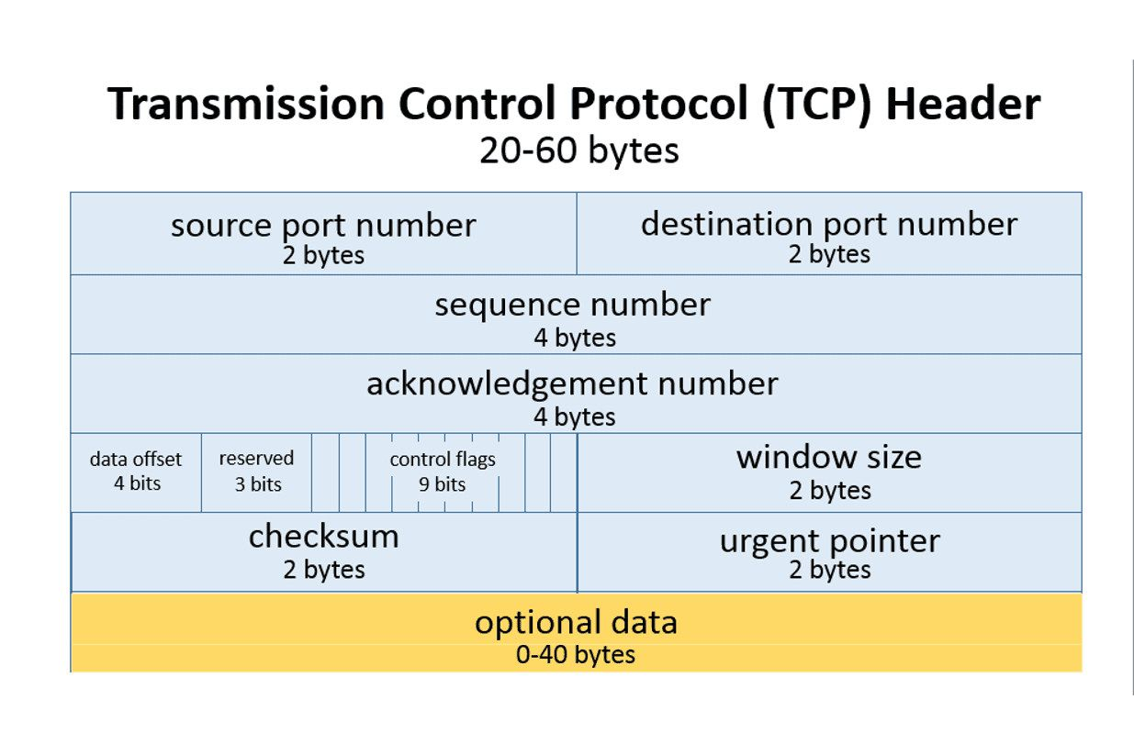
TCP Header

Slide 9
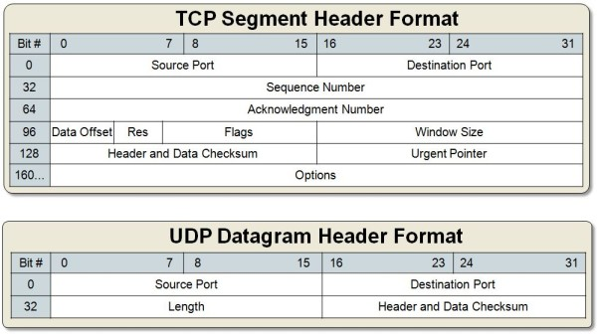
TCP Header vs UDP

Slide 10
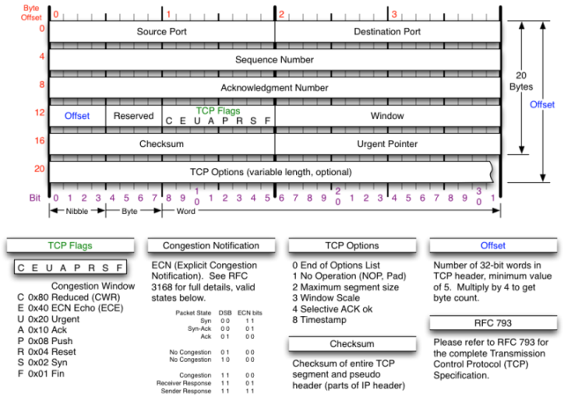
TCP Header

Slide 11
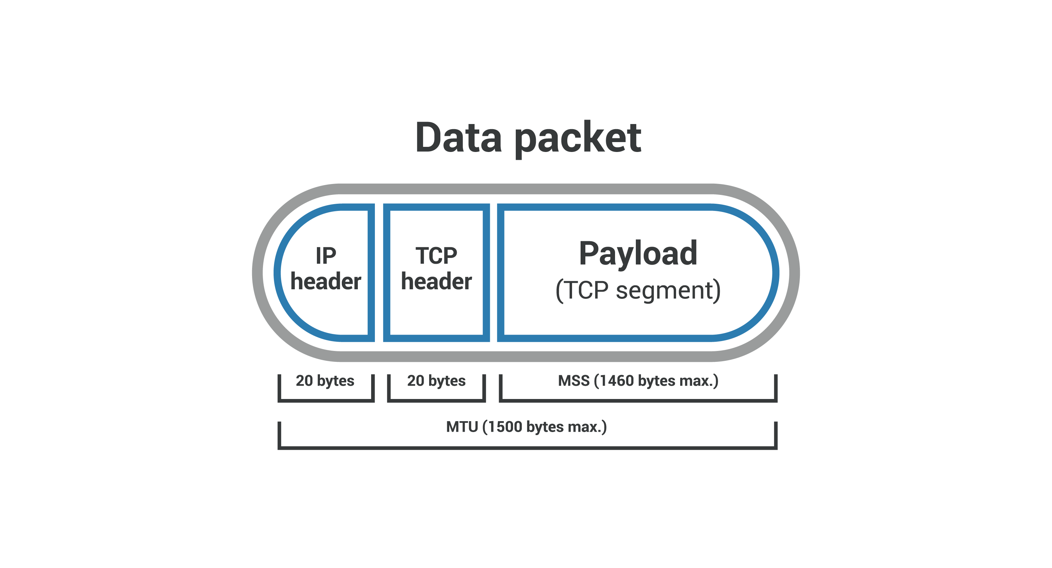
TCP Payload (Segment)

Slide 12
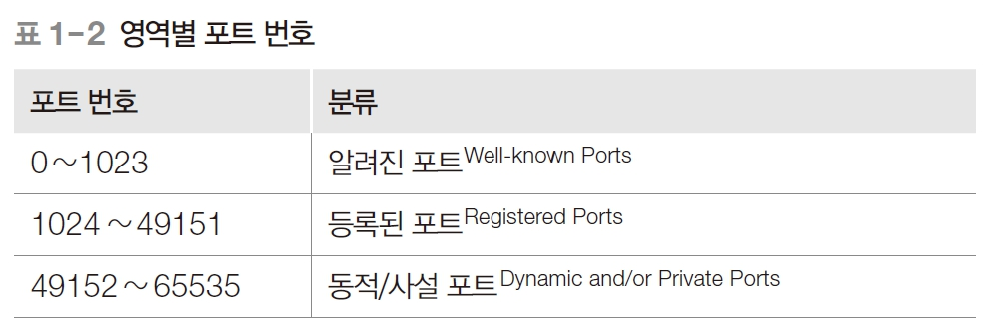
Port 번호

Slide 13
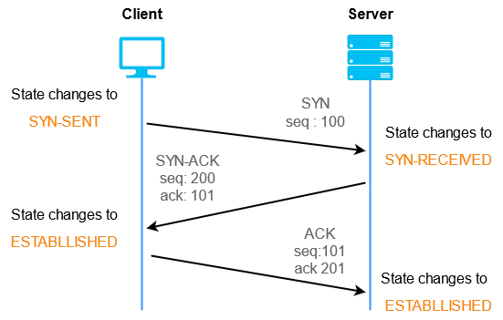
TCP 3-way handshake (connection)

Slide 14
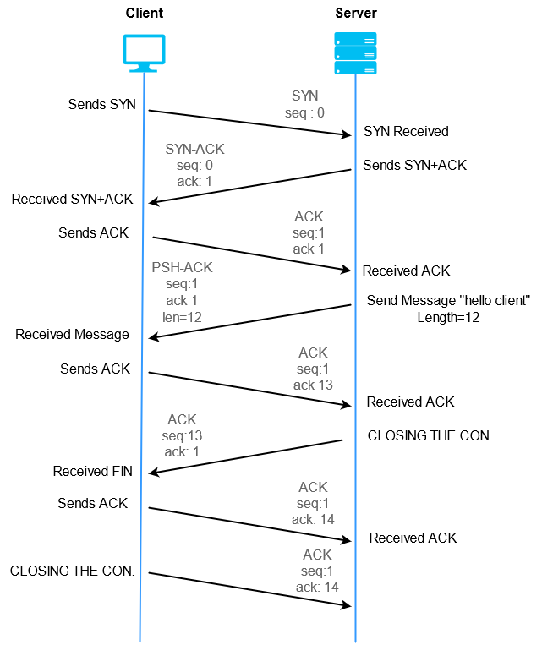
TCP stop & wait (data send-recv)

Slide 15
TCP stop & wait

Slide 16
TCP stop & wait

Slide 17
TCP communication

Slide 18
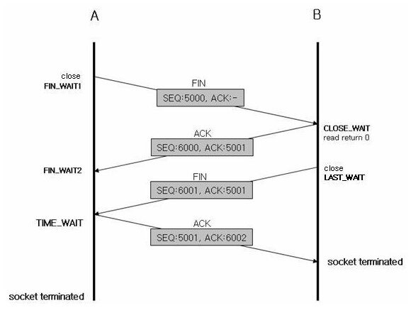
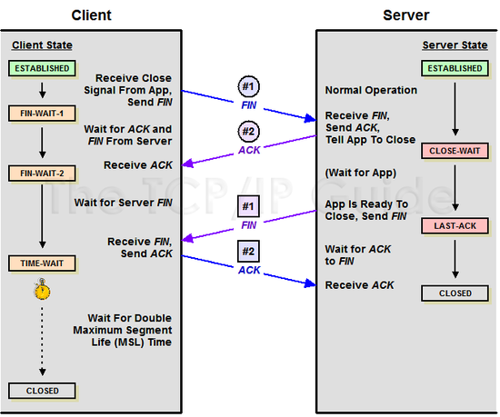
TCP 4-way handshake (close)

Slide 19
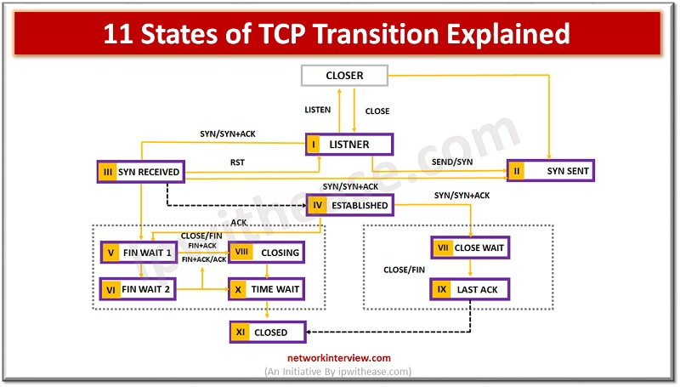
TCP state diagram
(recv/send)
function

Slide 20
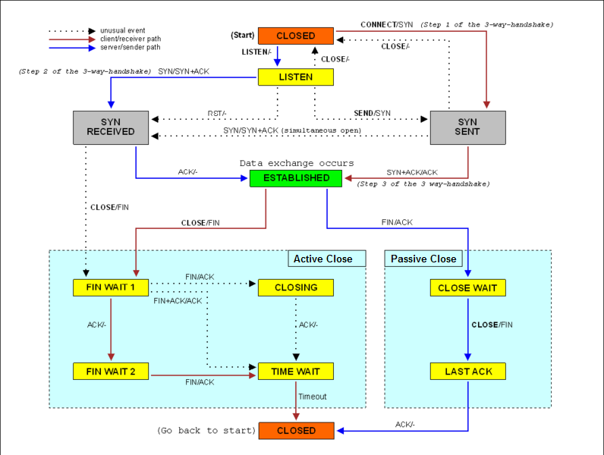

Slide 21
TCP 특징들
Segment Numbering
Connection Oriented
Full Duplex
Flow Control
Sliding window
Error control
SYN Flooding
Normal operation Rule1 ( ~ rule 6)
Lost segment
Lost Ack
Fast retransmission
Congestion Control (traffic in network)

Slide 22
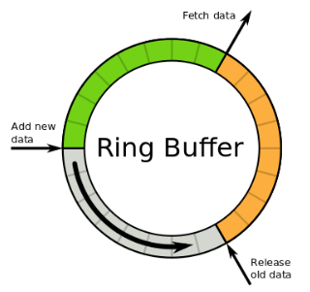
TCP 프로그래밍 필수항목
Ring Buffer
Queue
Header –Tailer
Circular (ring) data in/out

Slide 23
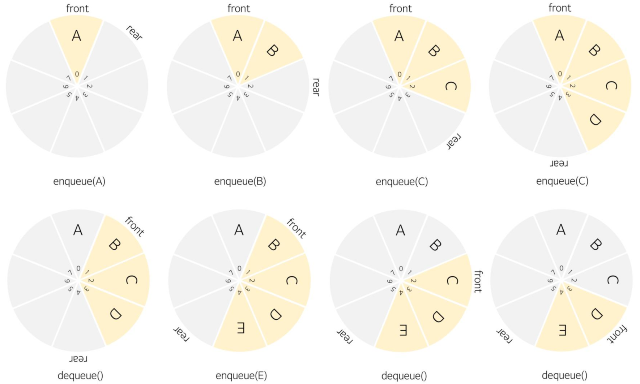

Slide 24
TCP 상위 프로토콜
HTTP/HTTPS
SSH
SMTP

Slide 25
테스트용 프로그램
Wireshark
SocketTest
SerialPortMon
Hercules
PacketSender
iperf3, iperf
Postman

